Slide 1
Data Science
Session – 6
Date – 20th May, 2022

Slide 2
R Tutorial
R is a programming language and software environment for statistical analysis, graphics representation and reporting. R was created by Ross Ihaka and Robert Gentleman at the University of Auckland, New Zealand, and is currently developed by the R Development Core Team.
The core of R is an interpreted computer language which allows branching and looping as well as modular programming using functions. R allows integration with the procedures written in the C, C++, .Net, Python or FORTRAN languages for efficiency.
R is freely available under the GNU General Public License, and pre-compiled binary versions are provided for various operating systems like Linux, Windows and Mac.
R is free software distributed under a GNU-style copy left, and an official part of the GNU project called GNU S.
Evolution of R
R was initially written by Ross Ihaka and Robert Gentleman at the Department of Statistics of the University of Auckland in Auckland, New Zealand. R made its first appearance in 1993.
A large group of individuals has contributed to R by sending code and bug reports.
Since mid-1997 there has been a core group (the "R Core Team") who can modify the R source code archive.
Features of R
As stated earlier, R is a programming language and software environment for statistical analysis, graphics representation and reporting. The following are the important features of R −
R is a well-developed, simple and effective programming language which includes conditionals, loops, user defined recursive functions and input and output facilities.
R has an effective data handling and storage facility,
R provides a suite of operators for calculations on arrays, lists, vectors and matrices.
R provides a large, coherent and integrated collection of tools for data analysis.
R provides graphical facilities for data analysis and display either directly at the computer or printing at the papers.
As a conclusion, R is world’s most widely used statistics programming language. It's the # 1 choice of data scientists and supported by a vibrant and talented community of contributors. R is taught in universities and deployed in mission critical business applications.

Slide 3
Local Environment Setup
Windows Installation
You can download the Windows installer version of R from R-3.2.2 for Windows (32/64 bit) and save it in a local directory.
Download the RStudio IDE - RStudio
As it is a Windows installer (.exe) with a name "R-version-win.exe". You can just double click and run the installer accepting the default settings. If your Windows is 32-bit version, it installs the 32-bit version. But if your windows is 64-bit, then it installs both the 32-bit and 64-bit versions.
After installation you can locate the icon to run the Program in a directory structure "R\R3.2.2\bin\i386\Rgui.exe" under the Windows Program Files. Clicking this icon brings up the R-GUI which is the R console to do R Programming.

Slide 4
R - Basic Syntax
R Command Prompt
Once you have R environment setup, then it’s easy to start your R command prompt by just typing the following command at your command prompt −
$ R
This will launch R interpreter and you will get a prompt > where you can start typing your program as follows −
myString <- "Hello, World!" > print ( myString) [1] "Hello, World!“
Here first statement defines a string variable myString, where we assign a string "Hello, World!" and then next statement print() is being used to print the value stored in variable myString.
R Script File
Usually, you will do your programming by writing your programs in script files and then you execute those scripts at your command prompt with the help of R interpreter called Rscript. So let's start with writing following code in a text file called test.R as under −
Live Demo
# My first program in R Programming myString <- "Hello, World!" print ( myString)
Save the above code in a file test.R and execute it at Linux command prompt as given below. Even if you are using Windows or other system, syntax will remain same.
$ Rscript test.R
When we run the above program, it produces the following result.
[1] "Hello, World!"

Slide 5
R - Data Types
The variables are assigned with R-Objects and the data type of the R-object becomes the data type of the variable. There are many types of R-objects. The frequently used ones are −
Vectors
Lists
Matrices
Arrays
Factors
Data Frames

Slide 6
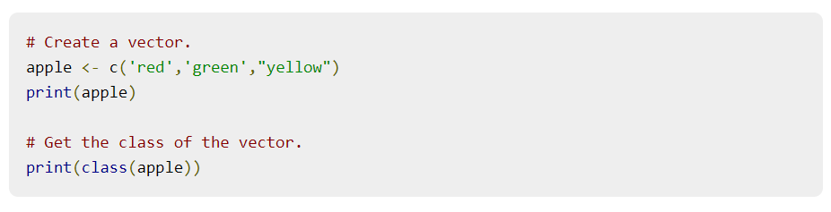
Vectors
When you want to create vector with more than one element, you should use c() function which means to combine the elements into a vector.

Slide 7
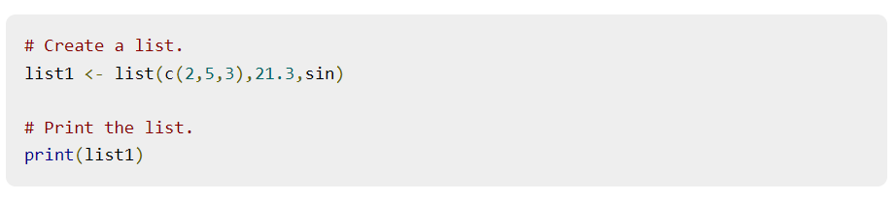
Lists
A list is an R-object which can contain many different types of elements inside it like vectors, functions and even another list inside it.

Slide 8
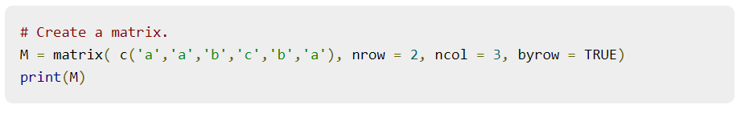
Matrices
A matrix is a two-dimensional rectangular data set. It can be created using a vector input to the matrix function.

Slide 9
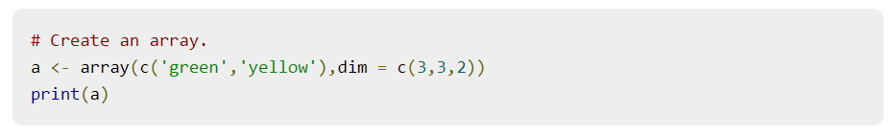
Arrays
While matrices are confined to two dimensions, arrays can be of any number of dimensions. The array function takes a dim attribute which creates the required number of dimension. In the below example we create an array with two elements which are 3x3 matrices each.

Slide 10
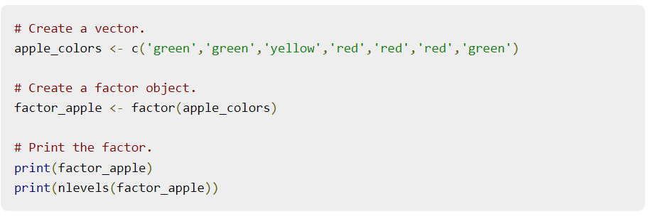
Factors
Factors are the r-objects which are created using a vector. It stores the vector along with the distinct values of the elements in the vector as labels. The labels are always character irrespective of whether it is numeric or character or Boolean etc. in the input vector. They are useful in statistical modeling.
Factors are created using the factor() function. The nlevels functions gives the count of levels.

Slide 11
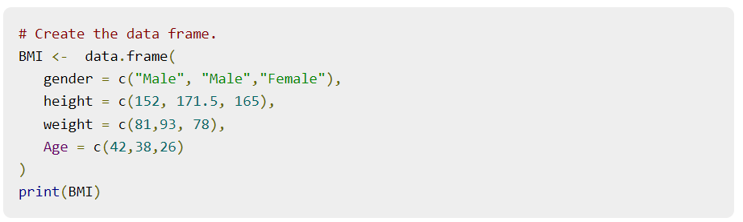
Data Frames
Data frames are tabular data objects. Unlike a matrix in data frame each column can contain different modes of data. The first column can be numeric while the second column can be character and third column can be logical. It is a list of vectors of equal length.
Data Frames are created using the data.frame() function.

Slide 12
R - Variables
A variable provides us with named storage that our programs can manipulate. A variable in R can store an atomic vector, group of atomic vectors or a combination of many Robjects. A valid variable name consists of letters, numbers and the dot or underline characters. The variable name starts with a letter or the dot not followed by a number.
Variable Name | Validity | Reason
var_name2. | valid | Has letters, numbers, dot and underscore
var_name% | Invalid | Has the character '%'. Only dot(.) and underscore allowed.
2var_name | invalid | Starts with a number
.var_name, var.name | valid | Can start with a dot(.) but the dot(.)should not be followed by a number.
.2var_name | invalid | The starting dot is followed by a number making it invalid.
_var_name | invalid | Starts with _ which is not valid

Slide 13
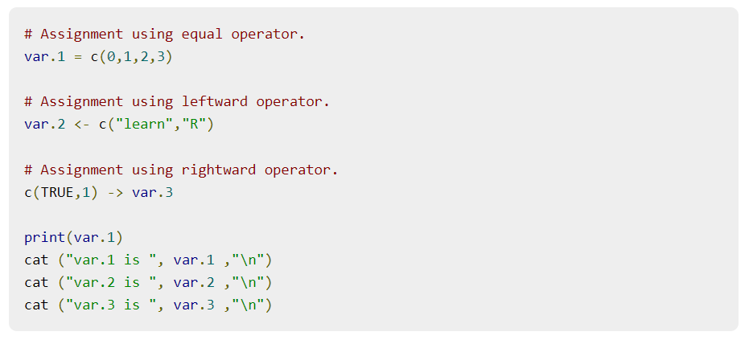
Variable Assignment
The variables can be assigned values using leftward, rightward and equal to operator. The values of the variables can be printed using print() or cat() function. The cat() function combines multiple items into a continuous print output.

Slide 14
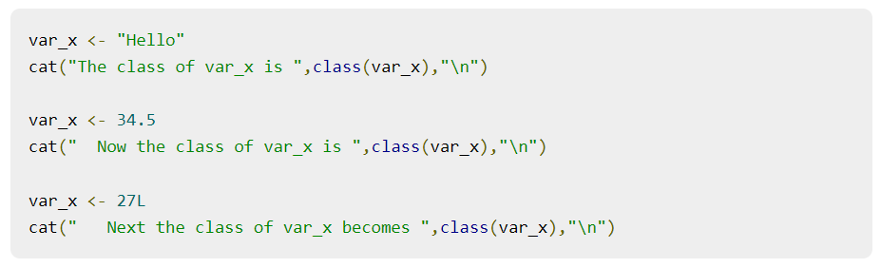
Data Type of a Variable
In R, a variable itself is not declared of any data type, rather it gets the data type of the R - object assigned to it. So R is called a dynamically typed language, which means that we can change a variable’s data type of the same variable again and again when using it in a program.

Slide 15
Finding Variables
To know all the variables currently available in the workspace we use the ls() function. Also the ls() function can use patterns to match the variable names.

Slide 16
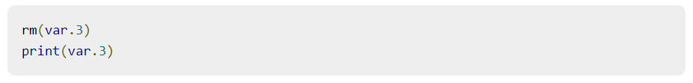
Deleting Variables
Variables can be deleted by using the rm() function. Below we delete the variable var.3. On printing the value of the variable error is thrown.

Slide 17
R - Operators
An operator is a symbol that tells the compiler to perform specific mathematical or logical manipulations. R language is rich in built-in operators and provides following types of operators.
Types of Operators
We have the following types of operators in R programming −
Arithmetic Operators
Relational Operators
Logical Operators
Assignment Operators
Miscellaneous Operators

Slide 18
Arithmetic Operators
Operator | Description | Example
+ | Adds two vectors | Live Demo v <- c( 2,5.5,6) t <- c(8, 3, 4) print(v+t)it produces the following result − [1] 10.0 8.5 10.0
− | Subtracts second vector from the first | Live Dem v <- c( 2,5.5,6) t <- c(8, 3, 4) print(v-t)it produces the following result − [1] -6.0 2.5 2.0
* | Multiplies both vectors | Live Demo v <- c( 2,5.5,6) t <- c(8, 3, 4) print(v*t)it produces the following result − [1] 16.0 16.5 24.0
/ | Divide the first vector with the second | Live Dem v <- c( 2,5.5,6) t <- c(8, 3, 4) print(v/t)When we execute the above code, it produces the following result − [1] 0.250000 1.833333 1.500000
%% | Give the remainder of the first vector with the second | v <- c( 2,5.5,6) t <- c(8, 3, 4) print(v%%t)it produces the following result − [1] 2.0 2.5 2.0
%/% | The result of division of first vector with second (quotient) | v <- c( 2,5.5,6) t <- c(8, 3, 4) print(v%/%t)it produces the following result − [1] 0 1 1
^ | The first vector raised to the exponent of second vector | v <- c( 2,5.5,6) t <- c(8, 3, 4) print(v^t)it produces the following result − [1] 256.000 166.375 1296.000

Slide 19
Relational Operators
Operator | Description | Example
> | Checks if each element of the first vector is greater than the corresponding element of the second vector. | Live Demo v <- c(2,5.5,6,9) t <- c(8,2.5,14,9) print(v>t)it produces the following result − [1] FALSE TRUE FALSE FALSE
< | Checks if each element of the first vector is less than the corresponding element of the second vector. | Live Demo v <- c(2,5.5,6,9) t <- c(8,2.5,14,9) print(v < t)it produces the following result − [1] TRUE FALSE TRUE FALSE
== | Checks if each element of the first vector is equal to the corresponding element of the second vector. | Live Demo v <- c(2,5.5,6,9) t <- c(8,2.5,14,9) print(v == t)it produces the following result − [1] FALSE FALSE FALSE TRUE
<= | Checks if each element of the first vector is less than or equal to the corresponding element of the second vector. | Live Demo v <- c(2,5.5,6,9) t <- c(8,2.5,14,9) print(v<=t)it produces the following result − [1] TRUE FALSE TRUE TRUE
>= | Checks if each element of the first vector is greater than or equal to the corresponding element of the second vector. | Live Demo v <- c(2,5.5,6,9) t <- c(8,2.5,14,9) print(v>=t)it produces the following result − [1] FALSE TRUE FALSE TRUE
!= | Checks if each element of the first vector is unequal to the corresponding element of the second vector. | Live Demo v <- c(2,5.5,6,9) t <- c(8,2.5,14,9) print(v!=t)it produces the following result − [1] TRUE TRUE TRUE FALSE

Slide 20
Logical Operators
The logical operator && and || considers only the first element of the vectors and give a vector of single element as output.
Operator | Description | Example
&& | Called Logical AND operator. Takes first element of both the vectors and gives the TRUE only if both are TRUE. | Live Demo v <- c(3,0,TRUE,2+2i) t <- c(1,3,TRUE,2+3i) print(v&&t)it produces the following result − [1] TRUE
|| | Called Logical OR operator. Takes first element of both the vectors and gives the TRUE if one of them is TRUE. | Live Demo v <- c(0,0,TRUE,2+2i) t <- c(0,3,TRUE,2+3i) print(v||t)it produces the following result − [1] FALSE
Operator | Description | Example
& | It is called Element-wise Logical AND operator. It combines each element of the first vector with the corresponding element of the second vector and gives a output TRUE if both the elements are TRUE. | Live Demo v <- c(3,1,TRUE,2+3i) t <- c(4,1,FALSE,2+3i) print(v&t)it produces the following result − [1] TRUE TRUE FALSE TRUE
| | It is called Element-wise Logical OR operator. It combines each element of the first vector with the corresponding element of the second vector and gives a output TRUE if one the elements is TRUE. | Live Demo v <- c(3,0,TRUE,2+2i) t <- c(4,0,FALSE,2+3i) print(v|t)it produces the following result − [1] TRUE FALSE TRUE TRUE
! | It is called Logical NOT operator. Takes each element of the vector and gives the opposite logical value. | Live Demo v <- c(3,0,TRUE,2+2i) print(!v)it produces the following result − [1] FALSE TRUE FALSE FALSE

Slide 21
Assignment Operators
Operator | Description | Example
<− or = or <<− | Called Left Assignment | Live Demo v1 <- c(3,1,TRUE,2+3i) v2 <<- c(3,1,TRUE,2+3i) v3 = c(3,1,TRUE,2+3i) print(v1) print(v2) print(v3)it produces the following result − [1] 3+0i 1+0i 1+0i 2+3i [1] 3+0i 1+0i 1+0i 2+3i [1] 3+0i 1+0i 1+0i 2+3i
-> or ->> | Called Right Assignment | Live Demo c(3,1,TRUE,2+3i) -> v1 c(3,1,TRUE,2+3i) ->> v2 print(v1) print(v2)it produces the following result − [1] 3+0i 1+0i 1+0i 2+3i [1] 3+0i 1+0i 1+0i 2+3i

Slide 22
R - Decision making
Decision making structures require the programmer to specify one or more conditions to be evaluated or tested by the program, along with a statement or statements to be executed if the condition is determined to be true, and optionally, other statements to be executed if the condition is determined to be false.

Slide 23
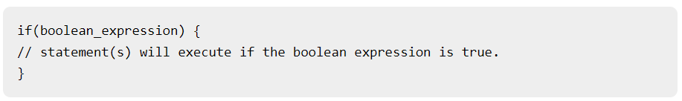
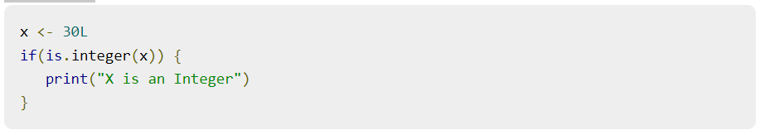
R - If Statement
Syntax
The basic syntax for creating an if statement in R is −
Example

Slide 24
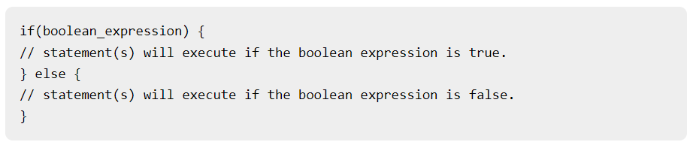
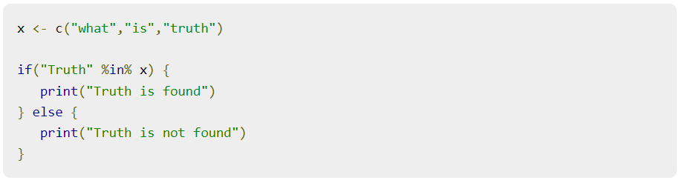
R - If...Else Statement
Syntax
The basic syntax for creating an if...else statement in R is −
Example

Slide 25
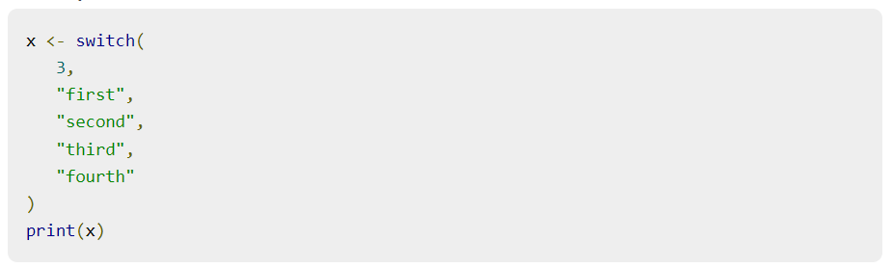
R - Switch Statement
Syntax
The basic syntax for creating a switch statement in R is −
Example

Slide 26
R - Loops

Slide 27
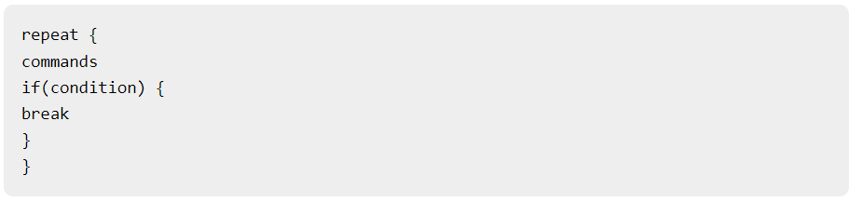
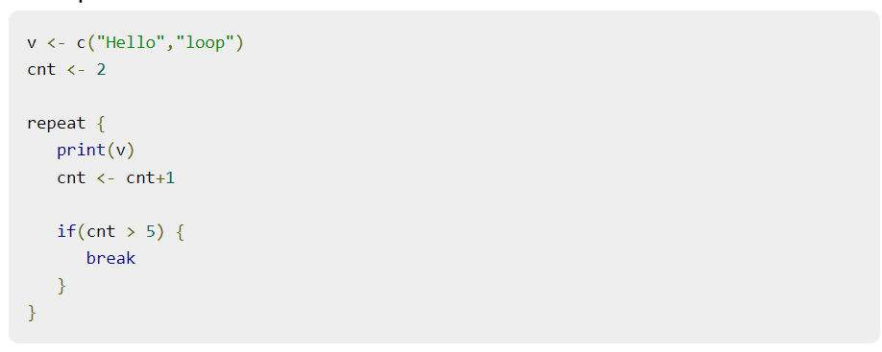
R - Repeat Loop
Syntax
The basic syntax for creating a repeat loop in R is −
Example

Slide 28
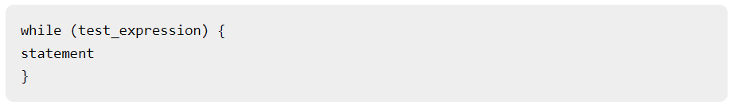
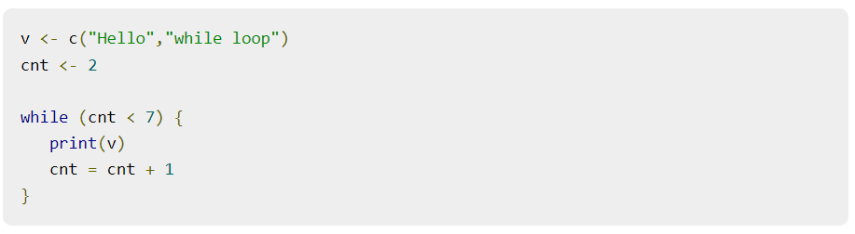
R - While Loop
Syntax
The basic syntax for creating a while loop in R is −
Example

Slide 29
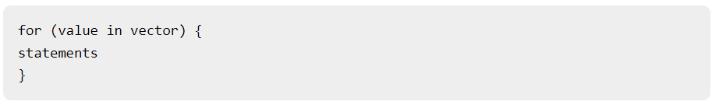
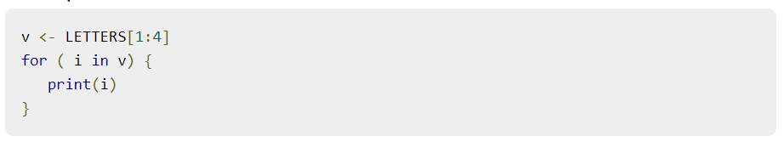
R - For Loop
Syntax
The basic syntax for creating a for loop statement in R is −
Example

Slide 30
R - Functions
A function is a set of statements organized together to perform a specific task. R has a large number of in-built functions and the user can create their own functions.
In R, a function is an object so the R interpreter is able to pass control to the function, along with arguments that may be necessary for the function to accomplish the actions.
The function in turn performs its task and returns control to the interpreter as well as any result which may be stored in other objects.

Slide 31
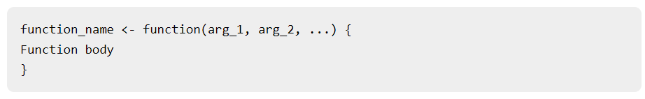
R - Functions
Function Definition
An R function is created by using the keyword function. The basic syntax of an R function definition is as follows −
Function Components
The different parts of a function are −
Function Name − This is the actual name of the function. It is stored in R environment as an object with this name.
Arguments − An argument is a placeholder. When a function is invoked, you pass a value to the argument. Arguments are optional; that is, a function may contain no arguments. Also arguments can have default values.
Function Body − The function body contains a collection of statements that defines what the function does.
Return Value − The return value of a function is the last expression in the function body to be evaluated.

Slide 32
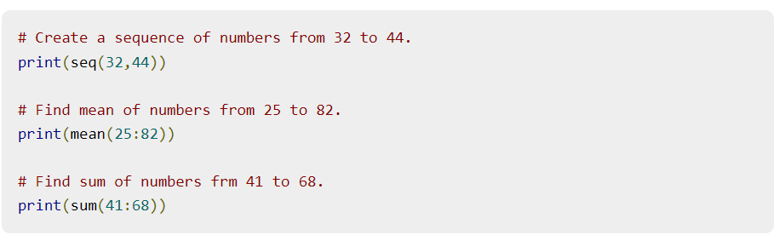
Built-in Function
Simple examples of in-built functions are seq(), mean(), max(), sum(x) and paste(...) etc. They are directly called by user written programs.

Slide 33
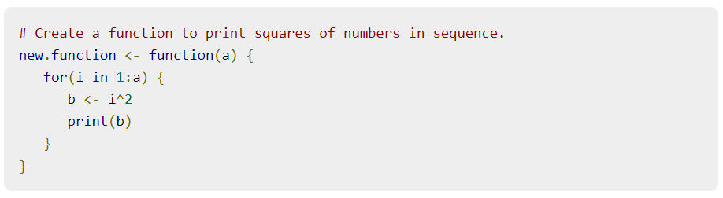
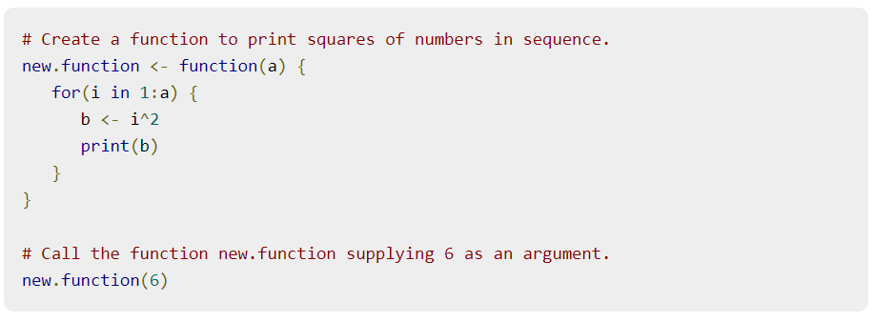
User-defined Function
We can create user-defined functions in R. They are specific to what a user wants and once created they can be used like the built-in functions. Below is an example of how a function is created and used.
Calling a Function

